Slide 1
You wake up…
… in a desolated forest and your only friend is a good-old trusted crossbow.
As the sun settles, there appears to be a human approaching you. Upon closer inspection you notice its deformed features.
It runs towards you, it points it’s claws in your direction and lunges at you.
You lift up your cross-bow and fire away. The creature is dead.
You are not alone…

Slide 2
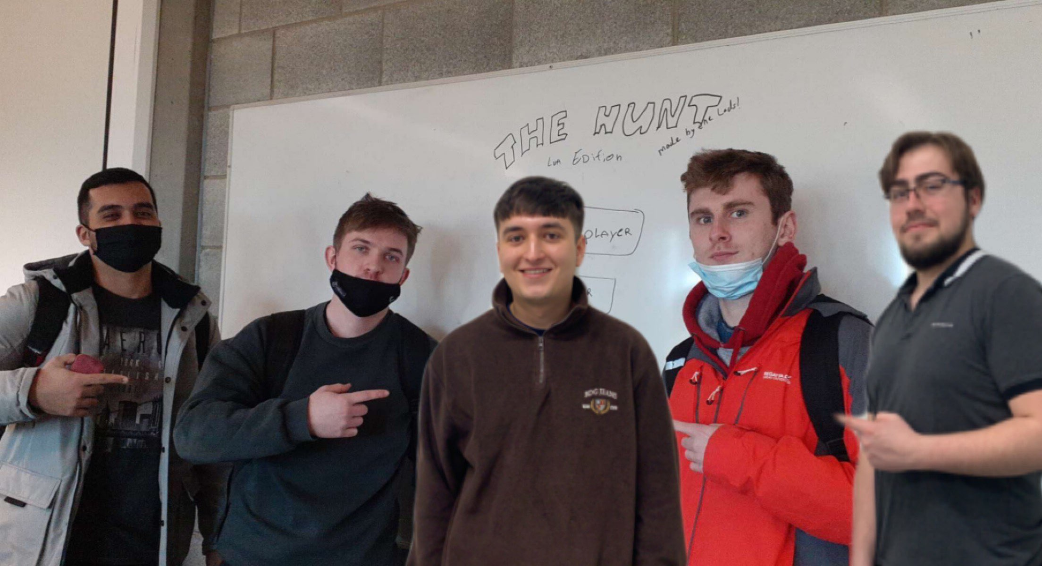
Who are we?
Our beloved group consists with five (not so) average college students.
As we are all different individuals, all of us have our own unique tastes in relation to games. However, we realised rather quickly that we are all not that different.
We all discussed what we like to play and after little discussion we settled on a game idea which we are now incorporating.

Slide 3
The Hunt
By: Milan Kovacs, Italo Terto da Silva, Stephen Fitzpatrick, Martynas Danys, Roger Shaw

Slide 4
Gameplay
The player must survive through a series of challenges.
There is a day and night cycle.
During the day there are animals where the player hunts them to get food and feed themselves.
The night is extremely dark, and the player only has a torch to show their way.
Meanwhile, there are enemies that chase the player during the night, and they keep getting stronger as the player progresses through the time cycle.
The player has a crossbow to use for hunting or to defend themselves against the enemies.
Note: the player cannot use the torch and the crossbow simultaneously.

Slide 5
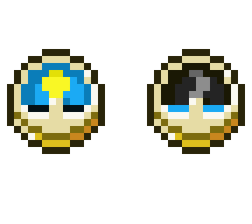
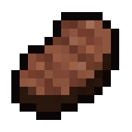
Mechanics
Random seed for each run
Time system (Day and Night)
Hunger System and hunting
Inventory management
Hot-bar and resource management
Pixel Arts took from Minecraft developed by Mojang Studios.

Slide 6
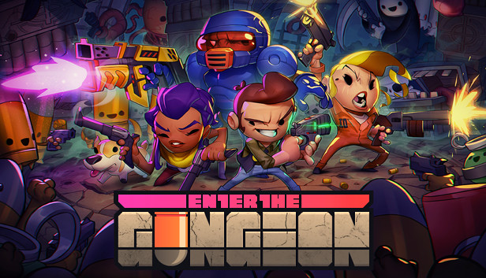


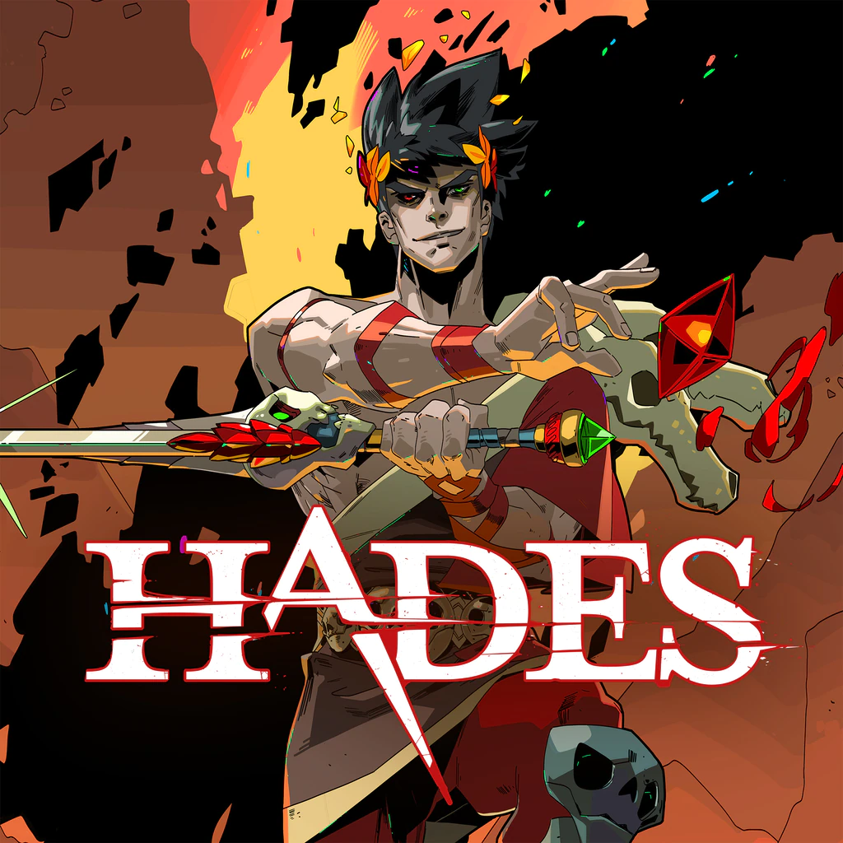
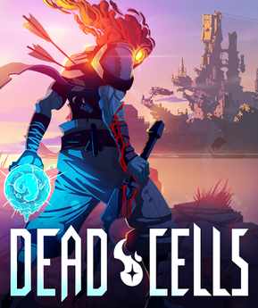
Target Audience
Genre
Casual players
Rogue-like

Slide 7
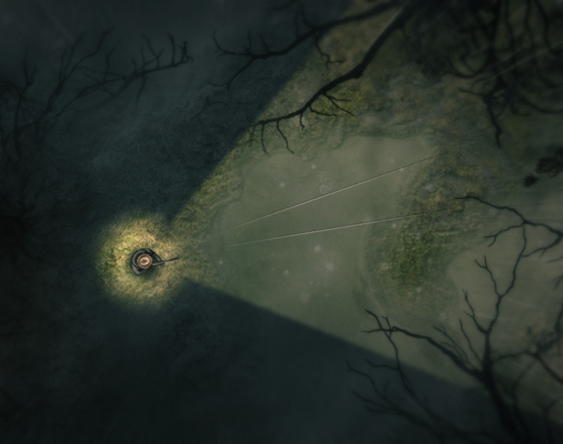
Night Vision
Here is an example of how the night vision would look in the game.
Screenshot took from a game called Darkwood, developed by Acid Wizard Studio.

Slide 8
Night vision explanation
As previously said, the night in this game is very dark.
In order to use night vision effectively, we are going to create a section of the screen which the player can see.
Using a rough approximation of the image in the slide just before this, the ratio is about 20% visibility.
This ratio of visible to non-visible would be ideal as there isn't too much visibility that it ruins the affect, there also isn't too little that would make the game overly difficult.
After determining how much visibility we want to give the player, we must calculate the area of a circle, subtract some angle that will be the 'visible' section, and make that the main background image.

Slide 9
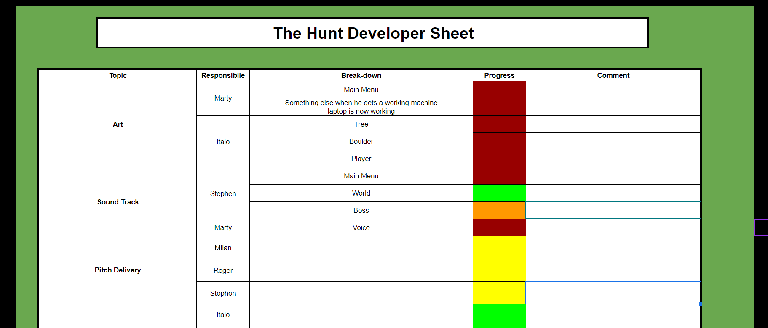
Road map
Multiplayer or local co-op.
Have a deeper look into the lore and expand it.
More mechanics (still a work in progress).
Develop more enemies, like a boss for example.
Create more areas/maps.

Slide 10
Future Plans
Multiplayer or local co-op.
Have a deeper look into the lore and expand it.
More mechanics (still a work in progress).
Develop more enemies, like a boss for example.
Create more areas/maps.
Reward the player for surviving.
This will depend on our time and resources

Slide 11
Thank you for listening!
Hope we have impressed you
The CompSci Læds

